Slide 1

ADULT CENSUS INCOME PREDICTION
ADULT CENSUS INCOME PREDICTION
BY,ARUN SHANKAR OVHAL
IT VEDANT THANE

Slide 2
MACHINE LEARNING PROJECT PROJECT NAME-ADULT CENSUS INCOME PREDICTION NAME-ARUN SHANKAR OVHAL IT VEDANT THANE
Description:
In this notebook, we are going to predict whether a person's income is above or below $50k yearly using various features like age, education, and occupation.
The dataset we are going to use is the Adult census income dataset from Kaggle which contains about 32,561 rows and 13 features.
The dataset contains the labels which we have to predict and the labels are discrete and binary. So the problem we have is a Supervised Classification type.

Slide 3
Motivation:
Building such predictive models can help us better understand the population of a country as well as the various factors affecting the economy. Governments can understand such factors and improve upon them leading to the growth of the country.

Slide 4
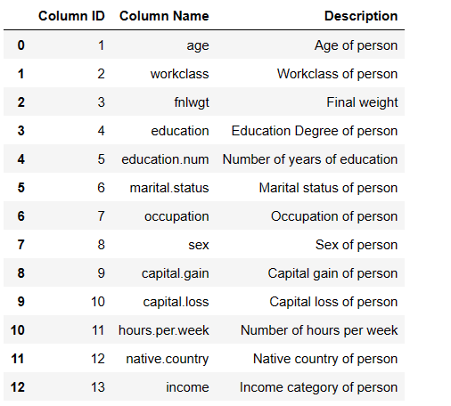
Features Description:

Slide 5
Step 0: Load libraries and dataset
import numpy as np
import pandas as pd
import matplotlib.pyplot as plt
import seaborn as sns
from sklearn.model_selection import train_test_split
from sklearn.linear_model import LogisticRegression
from sklearn.metrics import classification_report, accuracy_score
import warnings
warnings.filterwarnings("ignore")

Slide 6
Step 1:Importing Dataset
df=pd.read_csv(r"D:\ARUN DATA\DATA SCIENCE PRACTISE\Machine Learning\Project\adult (1).csv")
df

Slide 7
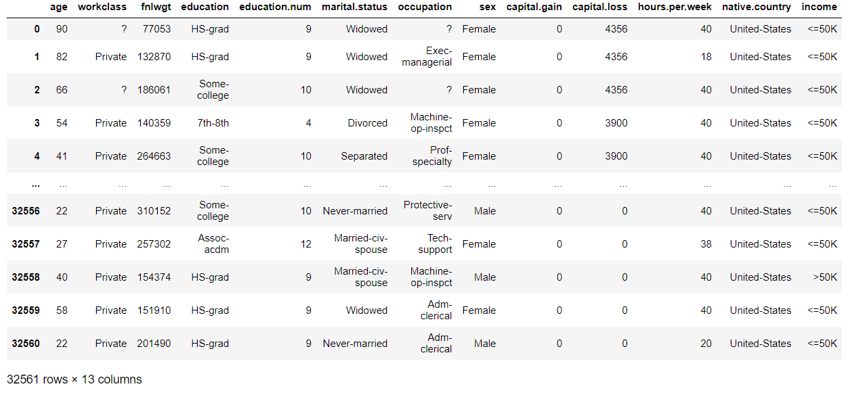

Slide 8
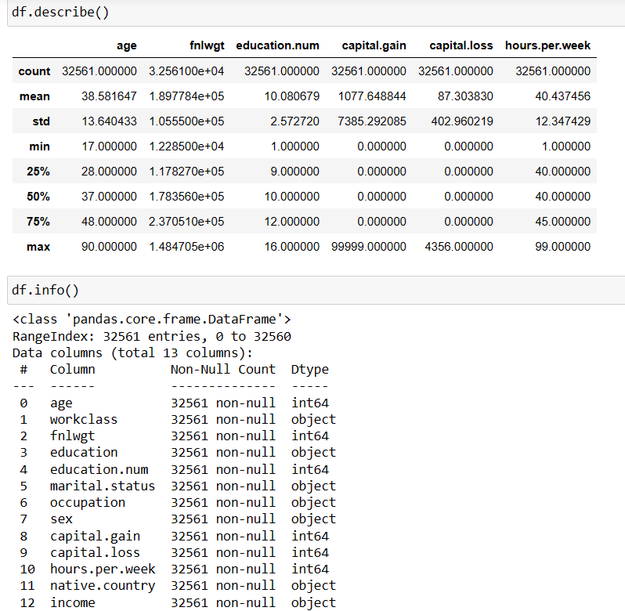

Slide 9
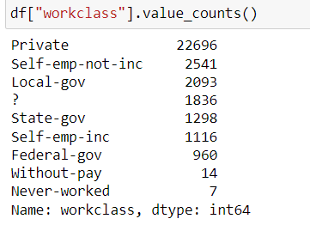
Step 2: Exploratory Data Analysis
Observations:
The dataset doesn't have any null values, but it contains missing values in the form of '?' which needs to be preprocessed.

Slide 10
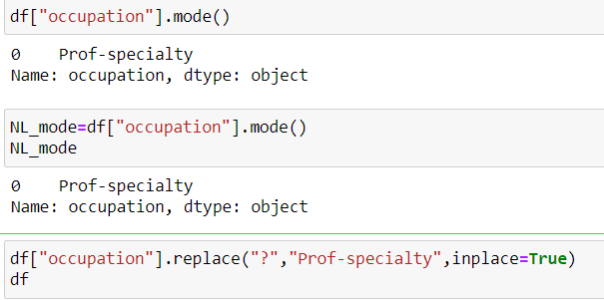
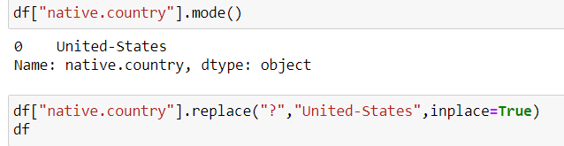

Slide 11
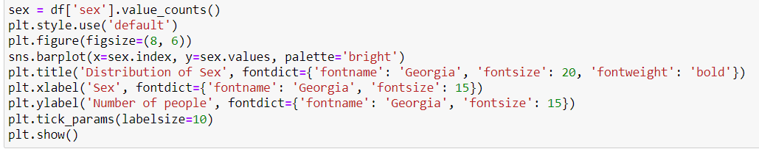
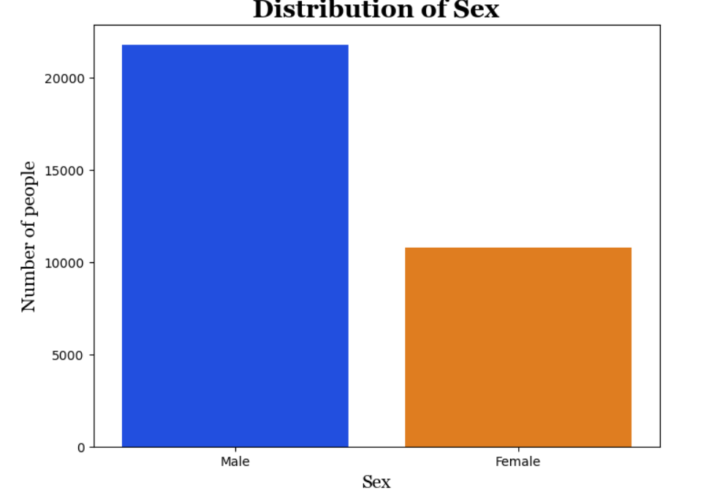
Step 2.1:Visualization .Graph 1
Observation:-
The bar graph provide the distribution of the 'sex' variable in the dataset, showcasing the proportion of males and females. Based on the graph, the following observations can be made.
The graph reveals a noticeable disparity between the number of males and females in the dataset. The proportion of males is observed to be greater than that of females.

Slide 12
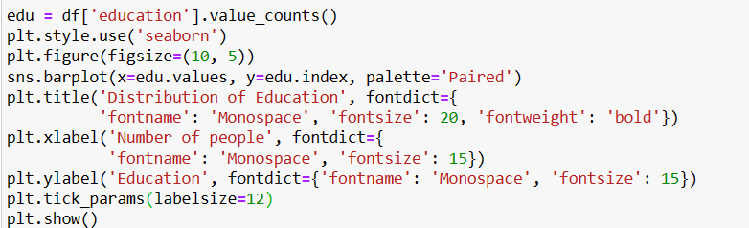
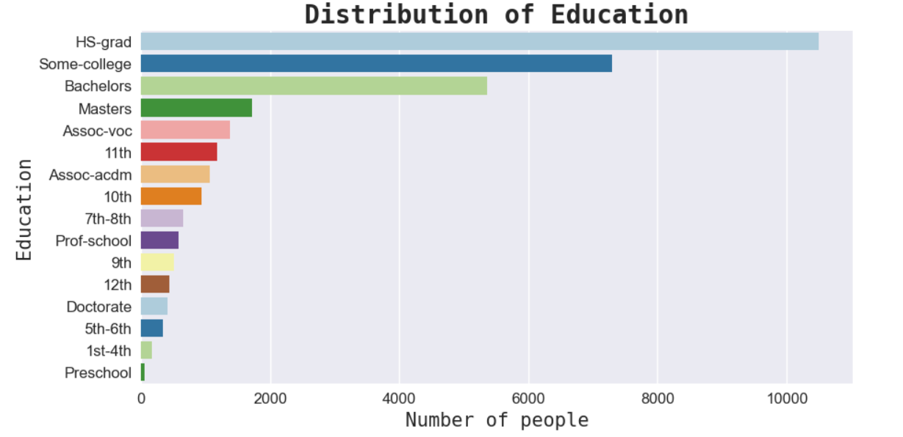
Graph 2
Observation:-
The above bar graph shows the distribution of Education where X-Axis labelled as "Number of people" and Y-Axis labelled as "Education". Based on the graph, the following observations can be made that highest number of people are HS Graduate, further it follows as Bachelors & Masters, Lowest number of people are preschool pass outs.

Slide 13
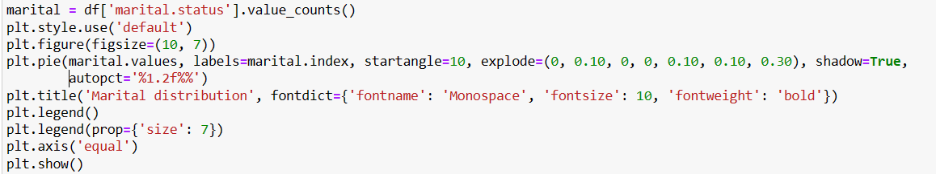
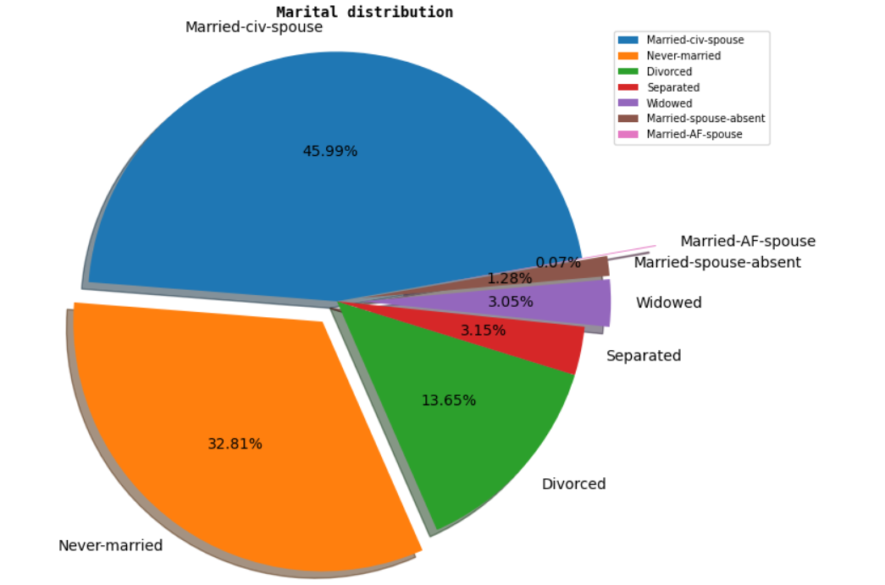
Graph 3
Observation:-
The above pie chart provides a visual representation of the distribution of marital status in the dataset. Based on the Charts, the following observations can be made that the percentage of married people is highest 45.99%,followed by Never Married 32.81%, and lowest is for Married-AF-Spouse 0.07%.

Slide 14
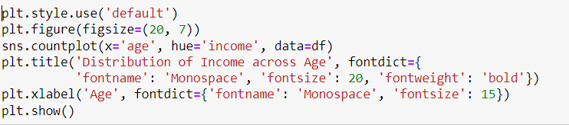
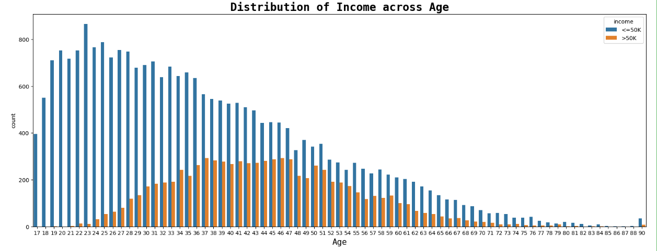
Graph 4
Observation:-
The count plot makes it possible to compare the income distribution among various age groups visually, which makes it easier to spot patterns or trends in the data. We discovered that while there was no increase in pay between the ages of 17 and 24, after they gained experience, an average increment above $50,000 was observed. We have thus shown that as we become older and gain more experience, our pay also tends to rise.

Slide 15
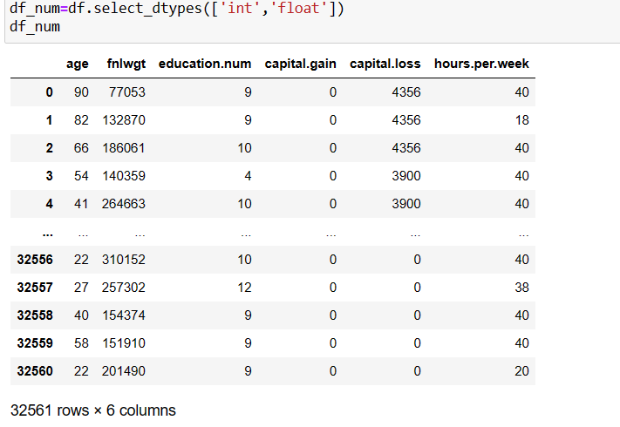
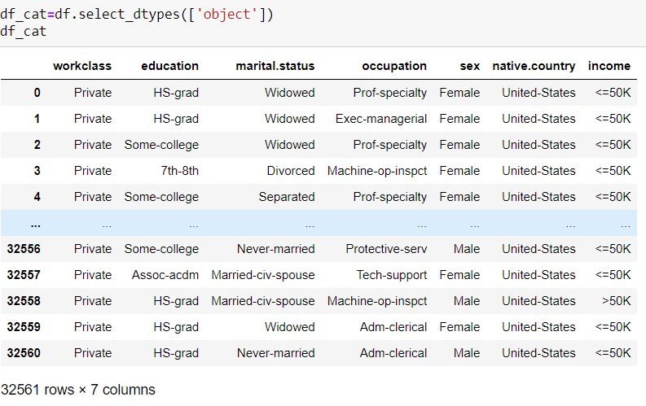
Step 2.2: Separating Numeric and category Data

Slide 16
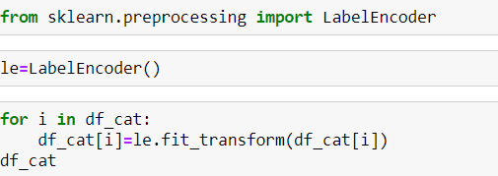
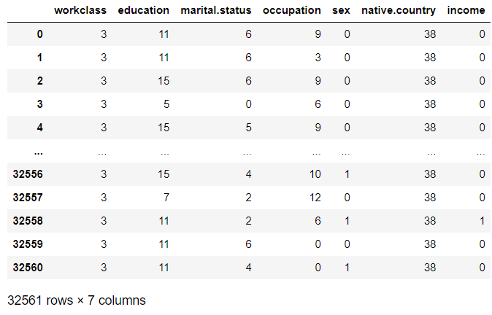
Step 2.3: Using Label Encoder for converting category data into numeric

Slide 17
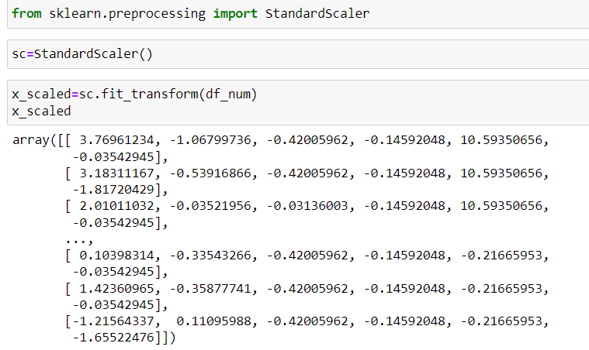
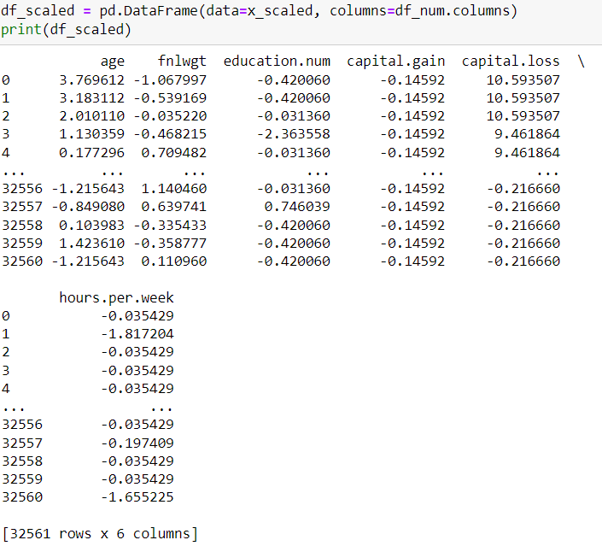
Step 2.4: Features Scaling

Slide 18
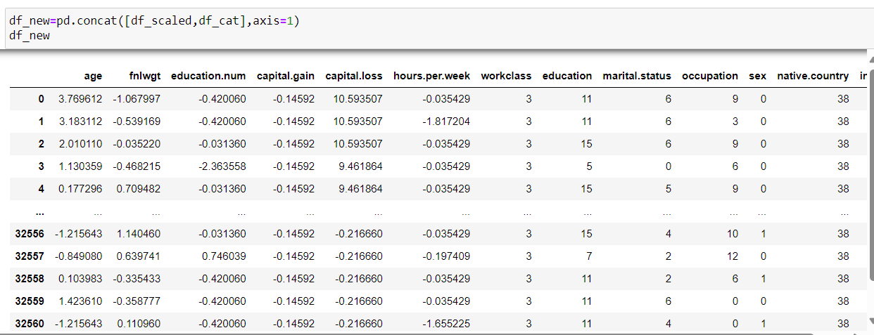
Step 2.5: Concatenate Numerical and Categorical Columns

Slide 19
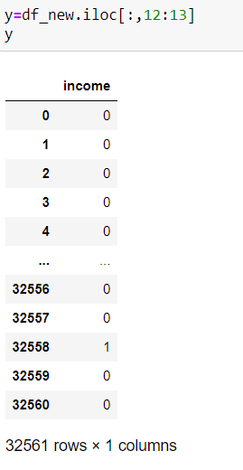
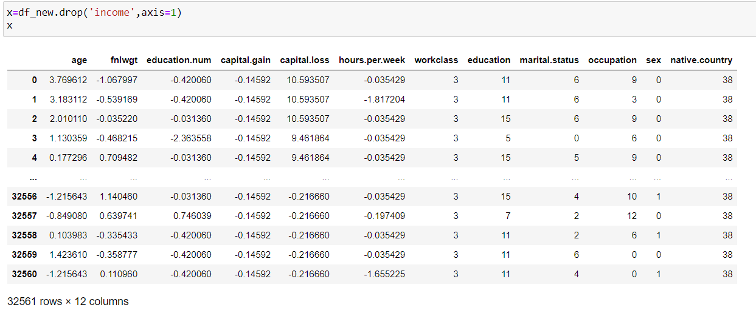
step 2.6:Splitting Data into X and Y

Slide 20
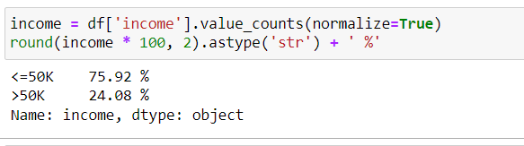
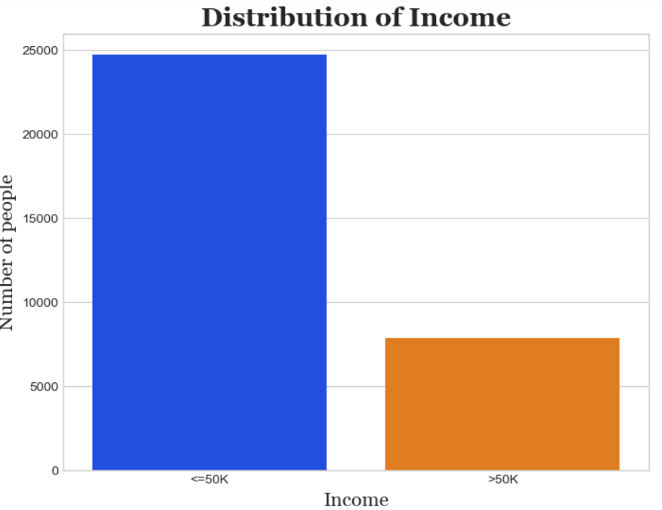
Observation: The dataset is unbalanced, as the dependent feature 'income' contains 75.92% values have income less than 50k and 24.08% values have income more than 50k.

Slide 21
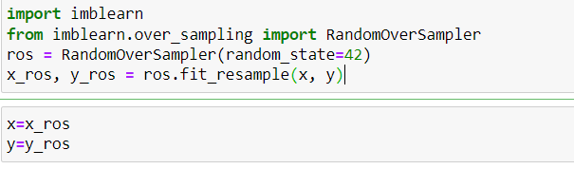
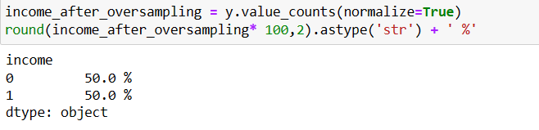
*Since the Data is imbalanced , need to do sampling (either Oversampling or Undersampling)

Slide 22
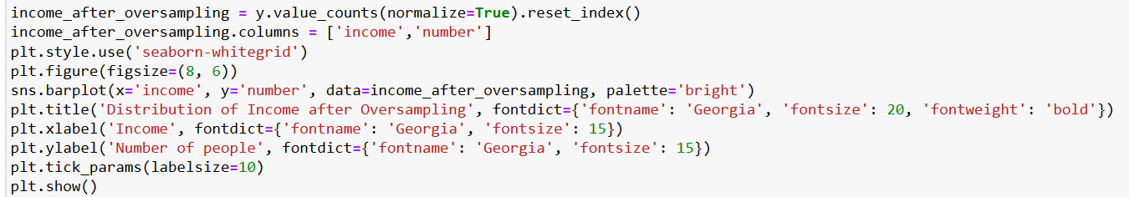
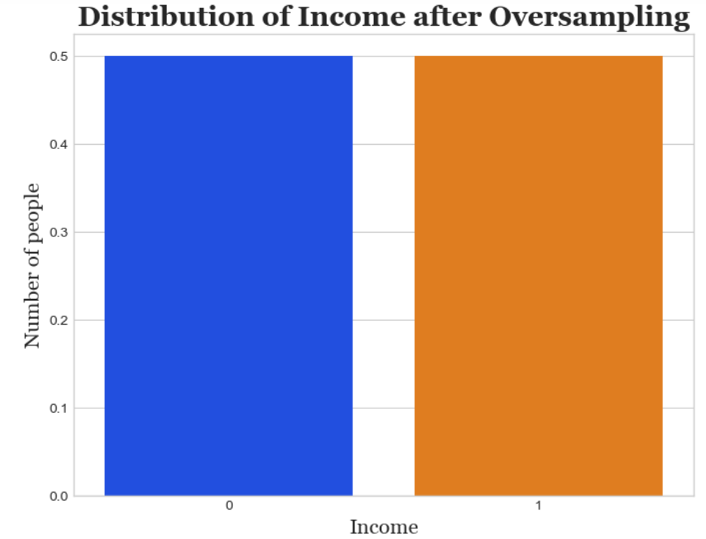
Observations:-
This code calculates and prints the percentage distribution of the 'income' column after oversampling. If the percentages are now more balanced compared to before oversampling, it indicates that the oversampling process has helped address the imbalance- issue in your dataset. where 0 indicates as salary <=50k and 1 indicates as salary >50k

Slide 23
step 3: Model Evaluation
There are two major types of supervised machine learning problems, called classification and regression. Our data set comes under Classification problem, as the prediction of a person's income is above 50k or below 50k. The supervised machine learning models (Classification) considered to train the dataset in this notebook are:
Logistic Regression
k-Nearest Neighbors Regression
Decision Tree
Random Forest
SVM
XG boost

Slide 24
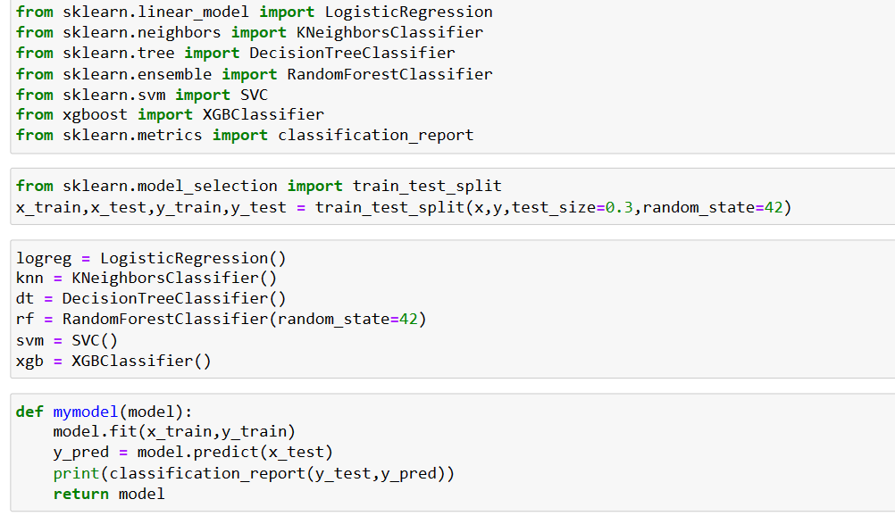
Importing Various Machine Learning Models

Slide 25
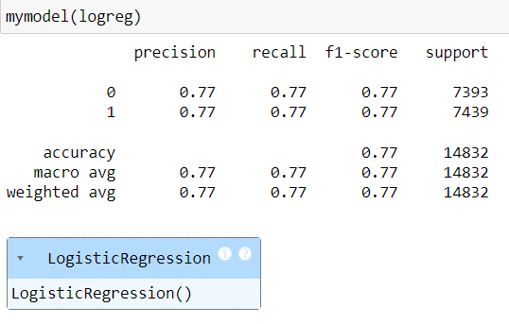
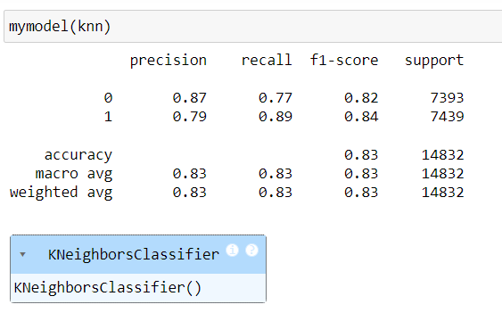
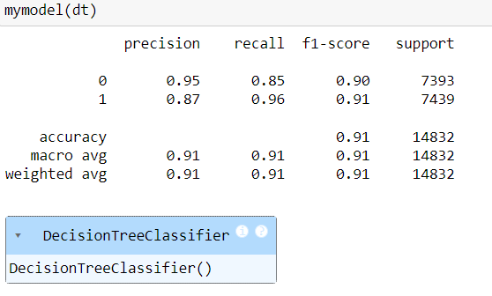
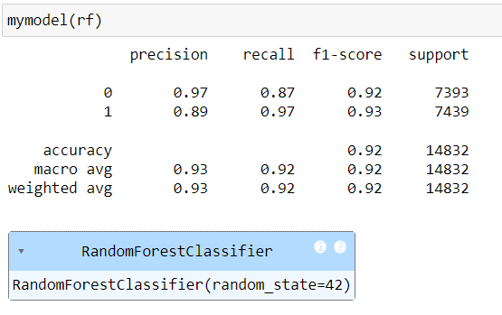
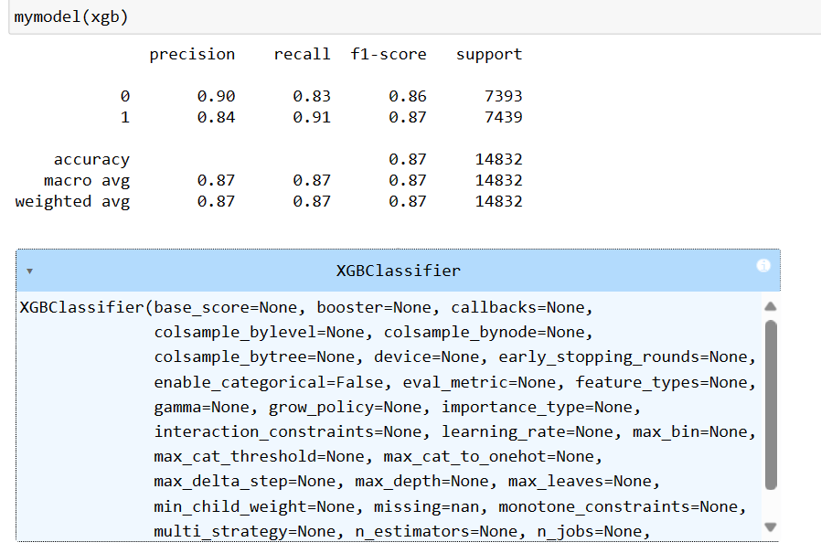

Slide 26
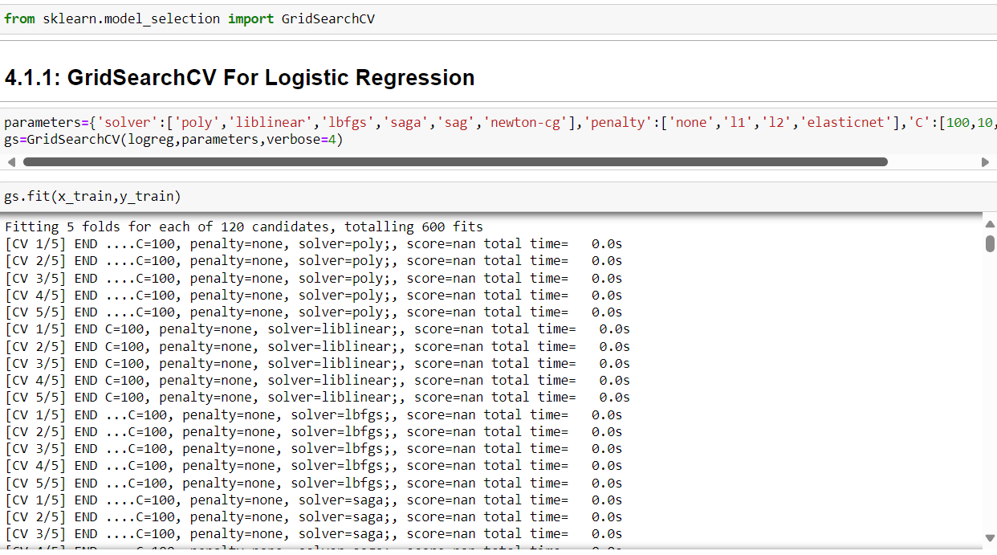
Step 4: Hyperparameter Tuning using Grid Search CV For Logistic Regression

Slide 27
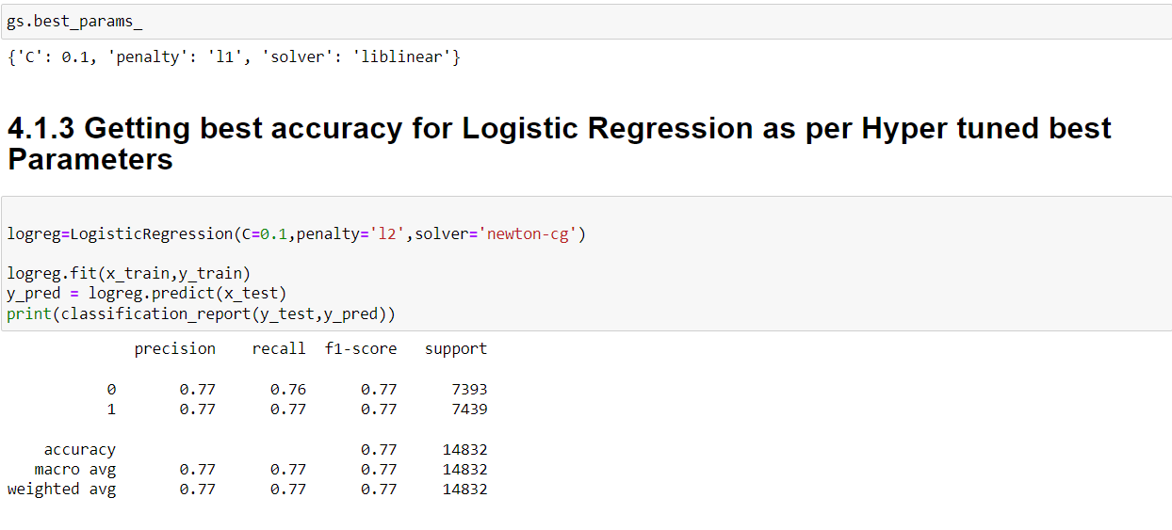

Slide 28
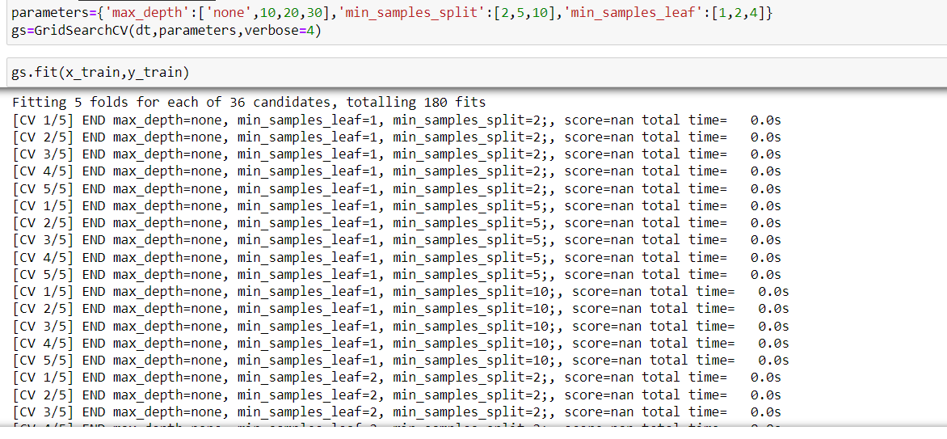
4.2: GridSearchCV For Decision Tree

Slide 29
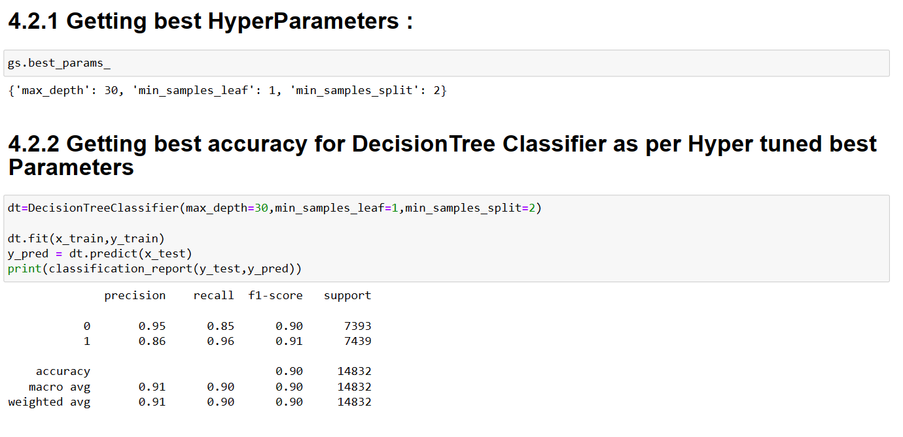

Slide 30
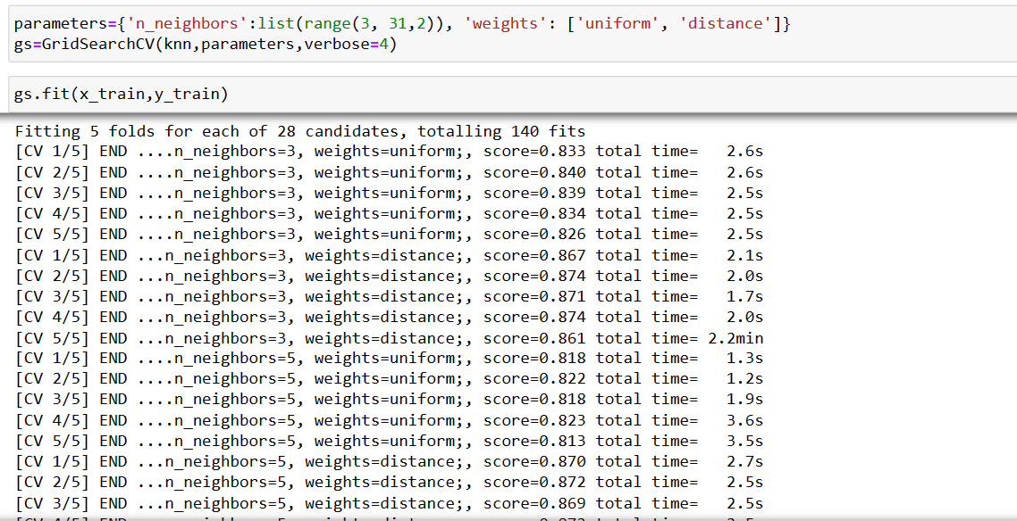
4.3: GridSearchCV For KNN

Slide 31
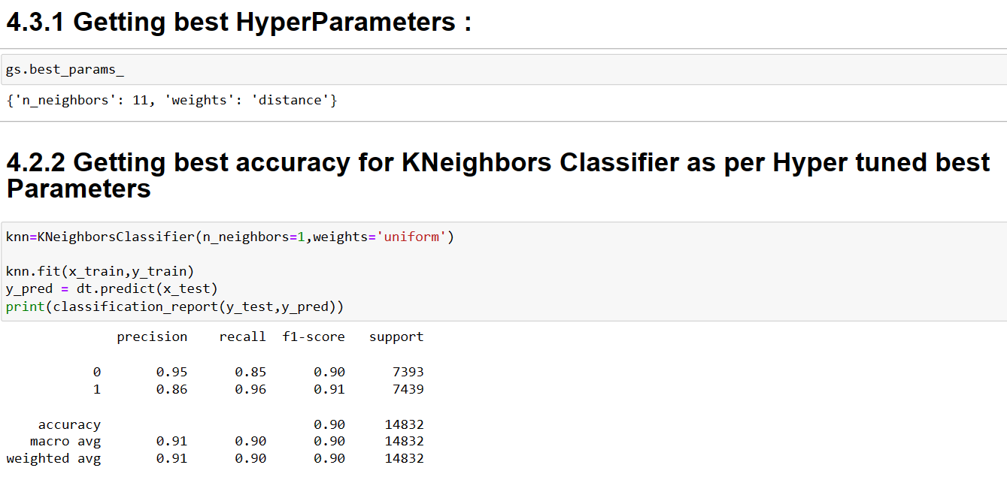

Slide 32
Conclusion:
In this project, we build various models like logistic regression, knn classifier, decision tree classifier, random forest classifier, XG Boost and Hyper Tuning Parameter Using GridSerachCV for Logistic Regression, Decision tree classifier & KNN
A Random Forest Classifier gives the highest accuracy score of 92.00 percent among all the ML Models.
Thus, for the Adult Census Income Prediction Dataset, the best accuracy can be achieved using Random Forest Model.
THANK YOU!

